Slide 1
Lecture Frame
An innovation in the world of lectures and learning.

Slide 2
Points to Discuss
Introduction to the technology
How it works
Touch Frame diversity
Components used
Application
Future thoughts

Slide 3
Introduction
Lecture Frame can turn plane surface into a Touch Surface.
Lectures can be recorded and live streamed at up to 100X size efficiency.
Live stream can take place on an average internet connection.
Lecture Frame is a framework that is sensitive to anything that is residing in its boundary.
It includes Touch Frame, a pre-processing phase controller and software.

Slide 4
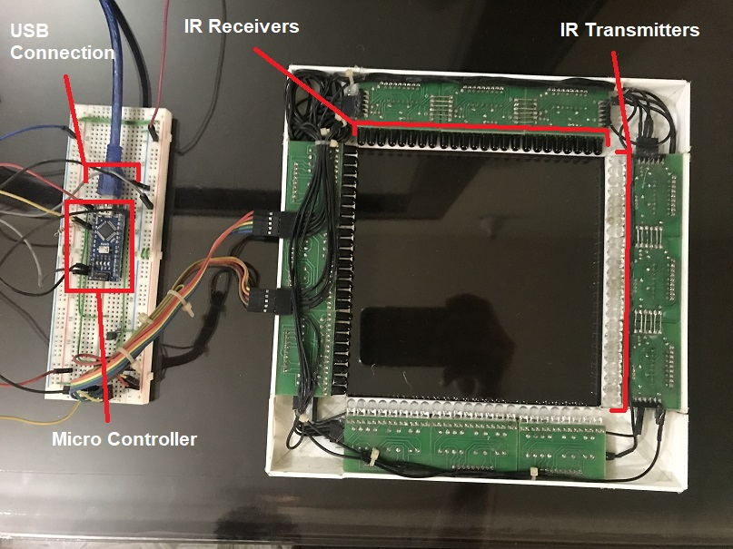
Prototype

Slide 5
Working
Using Lecture Frame, an ordinary White Board will be turned into a Touch Surface.
Anything written on White Board will be recorded and a Lecture file is generated as well as Live Streamed on Network.
Students that are not in the class, can attend Live Lecture either on their Laptops or can listen it later using Lecture File.
Video output viewed by a student will be same as Real Video Lecture. (e.g. on Khan Academy).

Slide 6
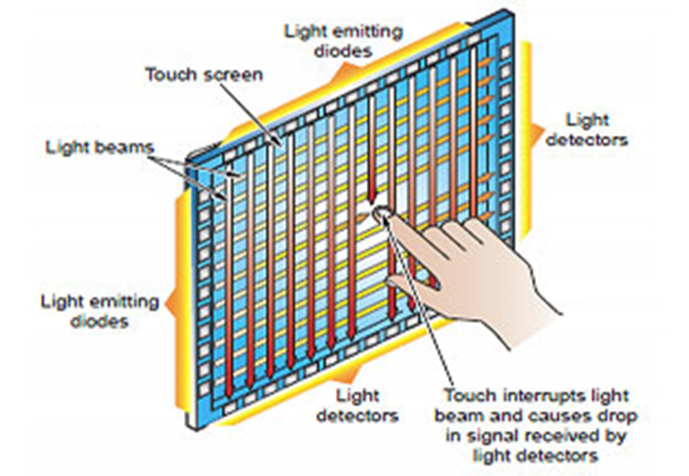
Project Framework

Slide 7
Diversity
Lecture Frame can Record Lectures at 100X size efficiency.
Lecture video can be Live Streamed on an Average Internet Connection.
Lecture Frame will be cost efficient as we have two project hardware architectures based on cost.
Lecture Frame will have its own Local Network so that Students don’t need any other internet connection.
Lecture Frame is ultra durable as compared to Touchpad.
Unlike Touchpad, Lecture Frame is sensitive to our specified Board Marker only.
Lecture Frame consists on smaller modules so that it makes transport and installation more easy than Touchpads.

Slide 8
Components Used
Touch Sensors
Touch Sensors are of two types based on module price
IR Transmitter / Receiver.
IR Cameras
Controller
There are two main hardware based controllers in project
Pre-processing phase controller (Raspberry Pi)
Actual-processing phase (Server)
Application Software
Software app is developed in Unity3d.

Slide 9
Application s
Lecture Frame can be synchronized with Multimedia Projectors to make a Touch Screen Display.
It can be used by all Education Institutions.
Online tutors can use Touch Frame for recording their lectures.
Artists can use Lecture Frame for their Digital Paintings as it is size variable, So that dimension of any writing area can be achieved.
Lecture Frame can record the writing even on a surface on which direct writing is difficult. Such as water.
Lecture Frame can be used as obstacle and motion sensor in Home Security System.

Slide 10
Future Thoughts
Students, Teachers, Artists online Live Training Centers will be using Lecture Frame.
There will be an innovation in Home Security and a whole new way of object tracking.
Making a Lecture Video up to 100X size efficient will make it easy to store number of attended and un-attended Lectures.
Making notes of Lectures will be easy and time-saving for Students.

